Slide 1

RESPONSIVE DESIGN
by OAI CHUNG

Slide 2
01.
What is responsive design?
02.
How does responsive design work?
03.
Media Queries

Slide 3
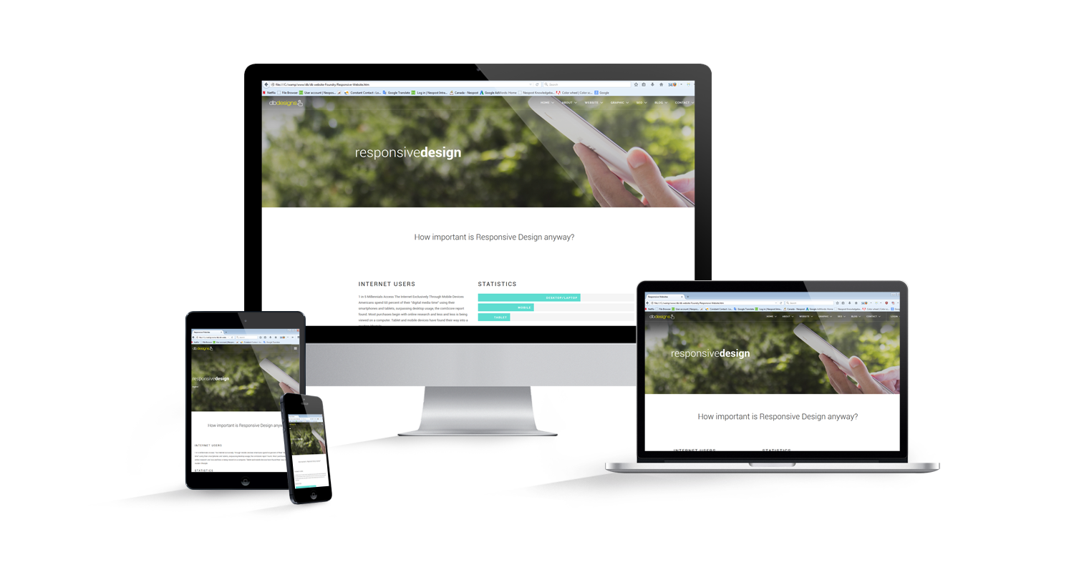
What is Responsive Design?
Responsive design is an approach whereby a designer creates a web page that “responds to” or resizes itself depending on the type of device it is being seen through.
Become an essential tool for anyone with a digital presence. With the growth of smartphones, tablets and other mobile computing devices, more people are using smaller-screens to view web pages.

Slide 4
Different screen sizes exist across phones, "phablets," tablets, desktops, game consoles, TVs, and even wearables.

Slide 5

Fluid Grids
The first key idea behind responsive design is the usage of what’s known as a fluid grid.
Page designs that are a fixed number of pixels across, and then centered on the page. However, when one considers the huge number of screen resolutions present in today’s market, the benefit of liquid layouts is too great to ignore.
Fluid grids go a few steps beyond the traditional liquid layout. Instead of designing a layout based on rigid pixels or arbitrary percentage values, a fluid grid is more carefully designed in terms of proportions.
This way, when a layout is squeezed onto a tiny mobile device or stretched across a huge screen, all of the elements in the layout will resize their widths in relation to one another.

Slide 6
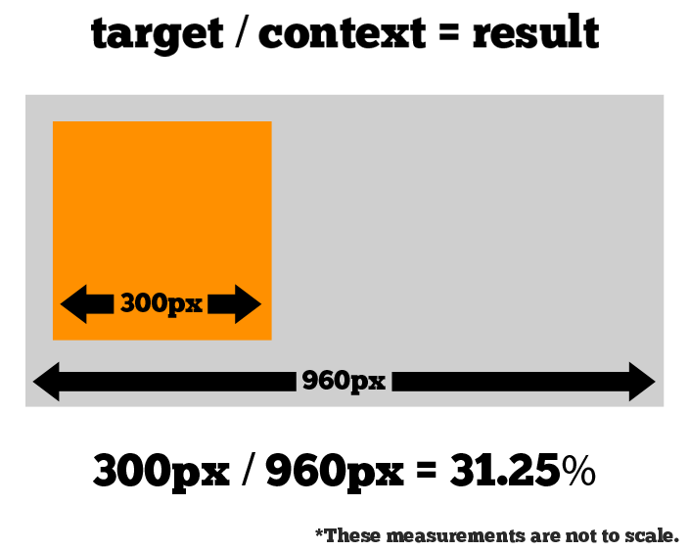
Calculate The Proportions
You must divide the target element by its context.
First create a high fidelity mockup in a pixel based imaged editor, like Photoshop.
With your high fidelity mockup in hand, you can measure a page element and divide it by the full width of the page.

Slide 7

Show/Hide Content
It is possible to shrink things proportionally and rearrange elements as necessary to make everything fit (reasonably well) as a screen gets smaller.
It’s great that that’s possible, but making every piece of content from a large screen available on a smaller screen or mobile device isn’t always the best answer.
We have best practices for mobile environments: simpler navigation, more focused content, lists or rows instead of multiple columns.
Responsive Web design shouldn’t be just about how to create a flexible layout on a wide range of platforms and screen sizes. It should also be about the user being able to pick and choose content. Fortunately, CSS has been allowing us to show and hide content with ease for years!

Slide 8
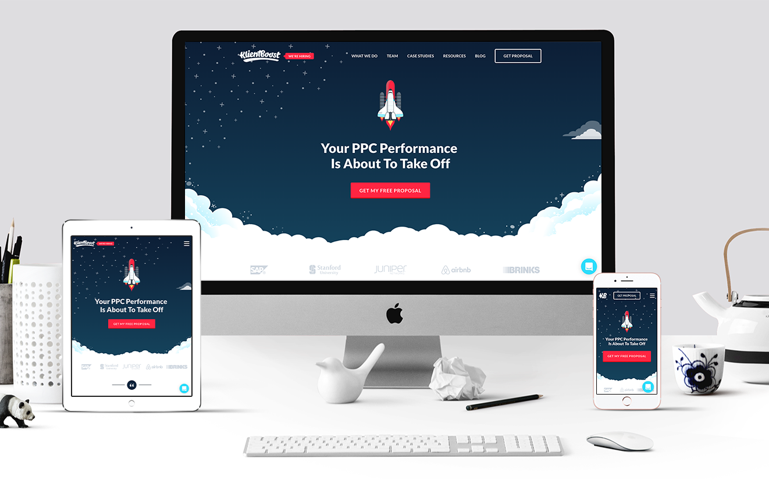

Slide 9
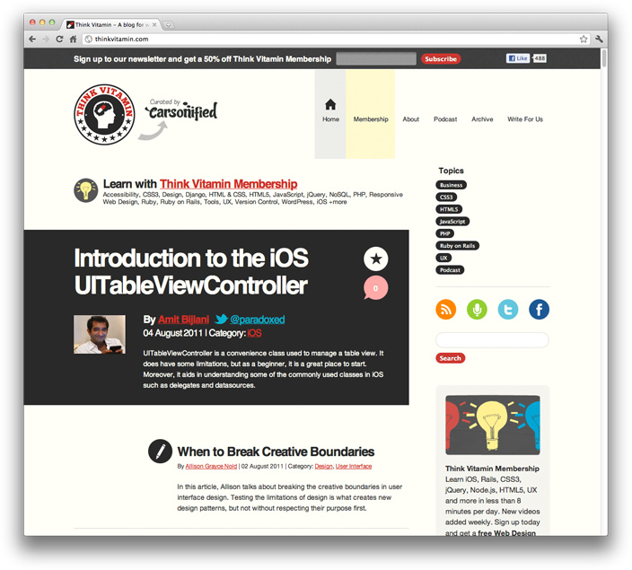
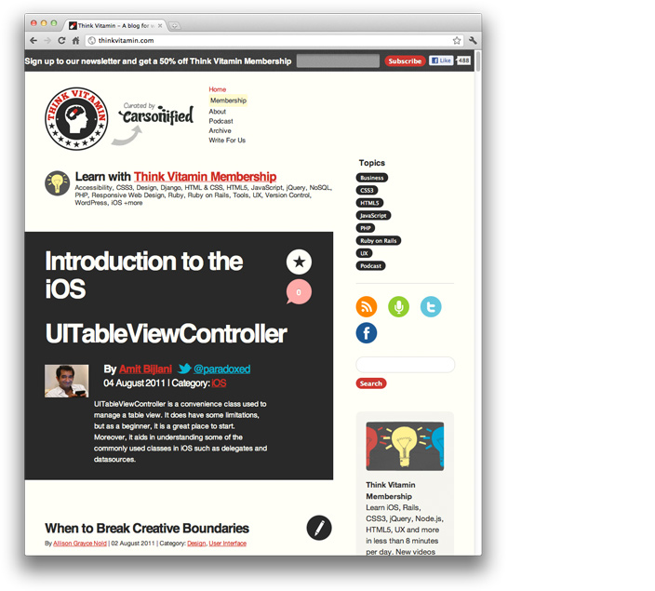
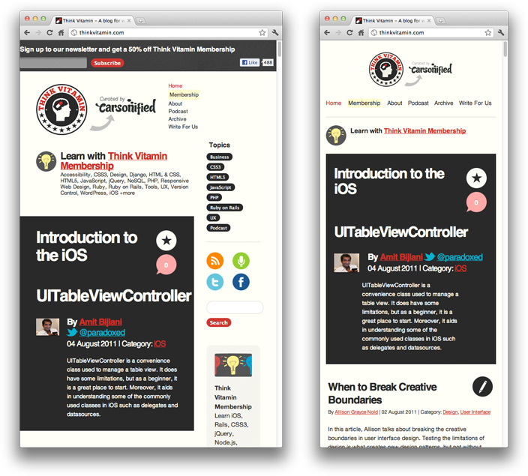

Slide 10
Meet The
Media Queries

Slide 11
Setup Viewport
The viewport is the user's visible area of a web page.
The viewport varies with the device, and will be smaller on a mobile phone than on a computer screen.
HTML5 introduced a method to let web designers take control over the viewport, through the <meta> tag.
You should include the following <meta> viewport element in all your web pages:
Use the <meta> viewport tag to control the width and scaling of the browser's viewport.
Include width=device-width to match the screen's width in device-independent pixels.
Include initial-scale=1 to establish a 1:1 relationship between CSS pixels and device-independent pixels.
Ensure your page is accessible by not disabling user scaling.

Slide 12
In addition to setting an initial-scale, you can also set the following attributes on the viewport:
minimum-scale: The minimum amount the visitor can zoom on the page. 1.0 does not zoom.
maximum-scale: The maximum amount the visitor can zoom on the page. 1.0 does not zoom.
user-scalable: Allows the device to zoom in and out. Values are yes or no.
When set, these can disable the user's ability to zoom the viewport, potentially causing accessibility issues.
Some additional rules to follow:
Do not use large fixed width elements.
Content should not rely on a particular viewport width to render well.
Use CSS media queries to apply different styling for small and large screens.

Slide 13
Media Queries
Since the days of CSS 2.1, our style sheets have enjoyed some measure of device awareness through media types. If you’ve ever written a print style sheet, you’re already familiar with the concept.
Thankfully, the W3C created media queries as part of the CSS3 specification, improving upon the promise of media types.
A media query allows us to target not only certain device classes, but to actually inspect the physical characteristics of the device rendering our work.
@media not | only mediatype and (media feature and | or | not media feature) {
CSS-Code;
}

Slide 14
CSS Syntax
@media not | only mediatype and (media feature and | or | not mediafeature) {
CSS-Code;
}
not: The not keyword reverts the meaning of an entire media query.
only: The only keyword prevents older browsers that do not support media queries with media features from applying the specified styles. It has no effect on modern browsers.
and: The and keyword combines a media feature with a media type or other media features.
They are all optional. However, if you use not or only, you must also specify a media type.

Slide 15
Media Type
Value | Description
all | Used for all media type devices
print | Used for printers
screen | Used for computer screens, tablets, smart-phones etc.
speech | Used for screenreaders that "reads" the page out loud

Slide 16
Media Feature
Value | Description
any-hover | Does any available input mechanism allow the user to hover over elements? (added in Media Queries Level 4)
any-pointer | Is any available input mechanism a pointing device, and if so, how accurate is it? (added in Media Queries Level 4)
aspect-ratio | The ratio between the width and the height of the viewport
color | The number of bits per color component for the output device
color-gamut | The approximate range of colors that are supported by the user agent and output device (added in Media Queries Level 4)
color-index | The number of colors the device can display
grid | Whether the device is a grid or bitmap
height | The viewport height
hover | Does the primary input mechanism allow the user to hover over elements? (added in Media Queries Level 4)
inverted-colors | Is the browser or underlying OS inverting colors? (added in Media Queries Level 4)

Slide 17
Value | Description
light-level | Current ambient light level (added in Media Queries Level 4)
max-aspect-ratio | The maximum ratio between the width and the height of the display area
max-color | The maximum number of bits per color component for the output device
max-color-index | The maximum number of colors the device can display
max-height | The maximum height of the display area, such as a browser window
max-monochrome | The maximum number of bits per "color" on a monochrome (greyscale) device
max-resolution | The maximum resolution of the device, using dpi or dpcm
max-width | The maximum width of the display area, such as a browser window
min-aspect-ratio | The minimum ratio between the width and the height of the display area
min-color | The minimum number of bits per color component for the output device
min-color-index | The minimum number of colors the device can display
min-height | The minimum height of the display area, such as a browser window
min-monochrome | The minimum number of bits per "color" on a monochrome (greyscale) device
min-resolution | The minimum resolution of the device, using dpi or dpcm

Slide 18
Value | Description
min-width | The minimum width of the display area, such as a browser window
monochrome | The number of bits per "color" on a monochrome (greyscale) device
orientation | The orientation of the viewport (landscape or portrait mode)
overflow-block | How does the output device handle content that overflows the viewport along the block axis (added in Media Queries Level 4)
overflow-inline | Can content that overflows the viewport along the inline axis be scrolled (added in Media Queries Level 4)
pointer | Is the primary input mechanism a pointing device, and if so, how accurate is it? (added in Media Queries Level 4)
resolution | The resolution of the output device, using dpi or dpcm
scan | The scanning process of the output device
scripting | Is scripting (e.g. JavaScript) available? (added in Media Queries Level 4)
update | How quickly can the output device modify the appearance of the content (added in Media Queries Level 4)
width | The viewport width

Slide 19
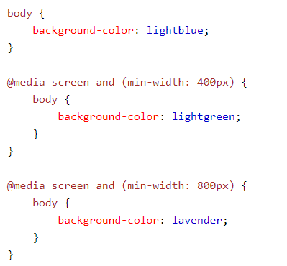

Media Queries Example

Slide 20
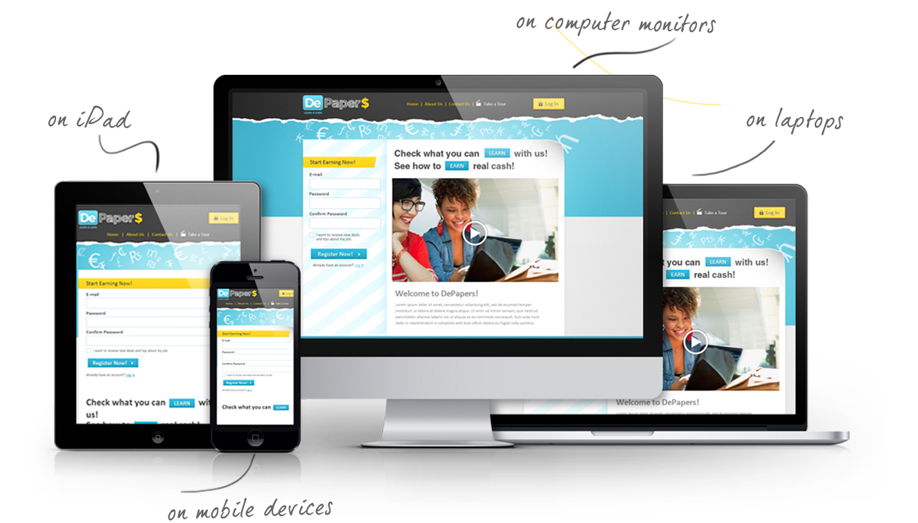
Recommend Pixel Widths
320px
375px
425px
768px
1024px
1440px
2560px

Slide 21
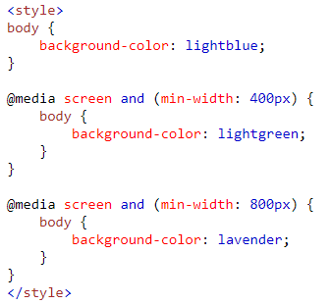
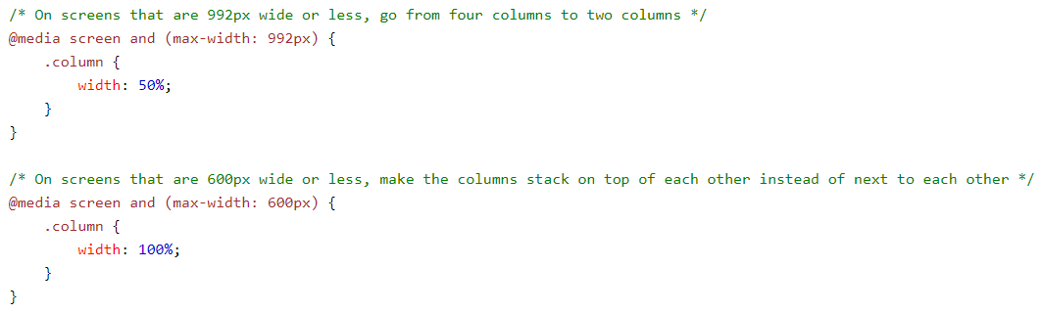
Different Stylesheets

Slide 22
Responsive Design
Example

Slide 23


